Slide 1
Basic Life Support (Integrated Guide)

Slide 2
Course Objectives
By the end of this course the student should be able to describe/demonstrate/recognize/perform the following:

Slide 3
Course Objectives
Describe the
steps of the Chain of Survival
Importance of High-Quality CPR
Importance of using an Automated External Defibrillator
Importance of teams in multi-rescuer resuscitation

Slide 4
Course Objectives
2. Recognize who NEEDS resuscitation efforts
3. Apply the concepts of Chain of Survival
3. Perform
high-quality CPR (adults, children, and infants)
As an effective team member

Slide 5
Course Objectives
4. Demonstrate the
The use of an AED
Effective ventilation delivery using a barrier device
Techniques to relieve foreign body obstruction

Slide 6
Course Objectives
4. Demonstrate the
The use of an AED
Effective ventilation delivery using a barrier device

Slide 7
Introduction
The goals of resuscitation are to:
preserve life
restore health
relieve suffering
limit disability
respect individuals’ decisions, rights, and privacy.

Slide 8
Introduction
Basic life support (BLS)
Advanced cardiovascular life support (ACLS)
Post–cardiac arrest care
are labels of convenience that each describe a set of skills and knowledge that are applied sequentially during the treatment of patients who have a cardiac arrest.

Slide 9
Introduction
Healthcare delivery require an effective system of care. It needs structure, process, system, and patient outcomes. Systems must be in place to address expected and unexpected challenges and the process must be continually monitored and re-examined to address flaws and failures.

Slide 10
Recognition
To combat delayed recognition of patient deterioration include
traditional electrocardiogram (ECG)-based telemetry
heart and respiratory rate sensors
increased clinician surveillance
Modified Early Warning Score (risk score)
laboratory data

Slide 11
Age Definition (American Heart Association BLS Provider Manual p.2)
Infant
Children
Adults
Less than 1 year of age
(excluding newborns in the delivery room)
1 year of age to puberty
*Signs of puberty include chest/underarm hair in males; any breast development in females
Adolescents and older

Slide 12
What is BLS?
It is the foundation for saving lives after Cardiac Arrest (AHA, 2016 p.1)
Basic Life Support
High-Quality CPR
AED and Bag-mask
Foreign Body Obstruction
Stroke
Team Dynamics
The skills you learn during the course can give victims the BEST CHANCE OF SURVIVAL

Slide 13
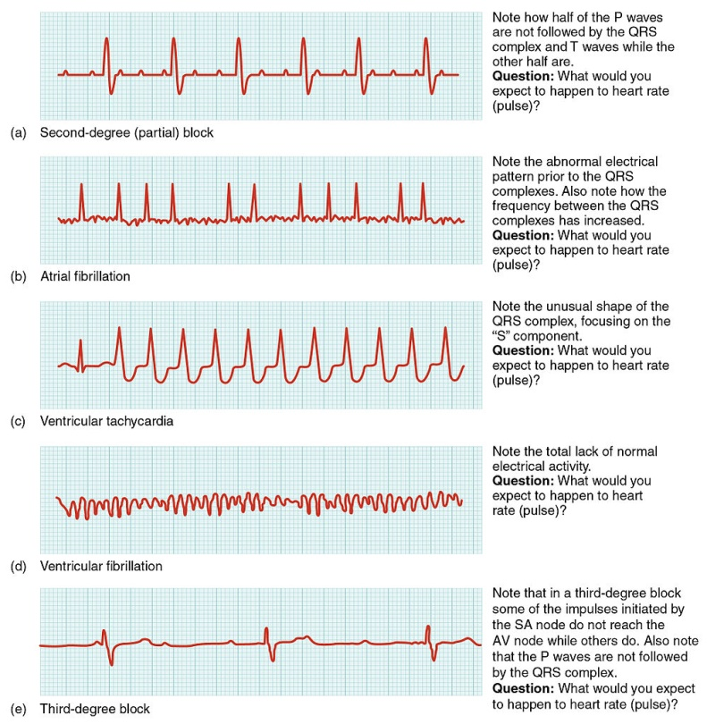
Cardiac Arrest
Sudden Cardiac Arrest
Heart develops an abnormal rhythm and cant pump blood (AHA, 2016, P. 10)

Slide 14
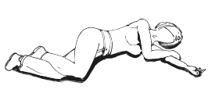
Cardiac Arrest

Slide 15
BLS Sequence
Notes:
https://eccguidelines.heart.org/tables/2015-basic-life-support-sequence/

Slide 16
Is the SCENE SAFE?
Resuscitation should generally be conducted where the patient is found. (Class IIa, LOE C) (2010 Part 5) HOWEVER if the environment is dangerous, it may be necessary to move the victim.

Slide 17
Is the patient RESPONDING?
Check for responsiveness (tap shoulder and shout, “Are you all right?”)

Slide 18
Activate emergency response!
When phoning 911, the bystander should be prepared to provide:
location of the incident,
the events of the incident,
the number and condition of the victim(s),
the type of aid provided.

Slide 19
Activate emergency response!
The bystander should:
be prepared to follow the dispatcher’s instructions.
hang up only when instructed to do so by the dispatcher.

Slide 20
Pulse and Breathing
Are ideally checked simultaneously for no more than 10 seconds. When in doubt, begin CPR!

Slide 21
Pulse and Breathing
Pulse (Strong)
Breathing (Normal)
Closely monitor the patient, and activate the emergency response system as indicated by location and patient condition.

Slide 22
Pulse and Breathing
Pulse (Strong)
Breathing (Abnormal e.g. gasping)
Suspect OPIOD OVERDOSE
it is reasonable for appropriately trained BLS healthcare providers to administer intramuscular or intranasal naloxone. (Class IIa, LOE C-LD) (2015 Part 5)

Slide 23
Pulse and Breathing
Pulse (Weak, thready, uncertain)
Breathing (Abnormal e.g. gasping)
Call for help, Begin CPR!
For patients in cardiac arrest, medication administration is ineffective without concomitant chest compressions for drug delivery to the tissues, so naloxone administration may be considered after initiation of CPR if there is high suspicion for opiate overdose. (Class IIb, LOE C-EO) (2015 Part 5)

Slide 24
Chest Compressions
forceful rhythmic applications of pressure over the lower half of the sternum.

Slide 25
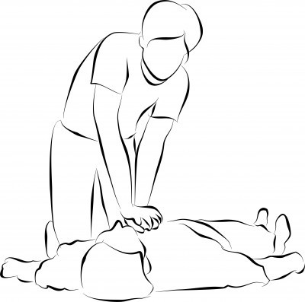
High Quality Cardio-Pulmonary Resuscitation
Main Components (AHA, 2016 p.3)
Chest Compressions
Breaths

Slide 26
HIGH QUALITY CHEST COMPRESSIONS
Characteristics of effective chest compressions:
adequate depth (2-2.4 inches or 5-6 cm)
adequate rate (100-120/min)
complete recoil after each compression
minimal number and duration of interruptions in chest compressions

Slide 27
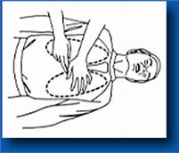
Hand Position
It is reasonable to position hands for chest compressions on the lower half of the sternum in adults with cardiac arrest. (Class IIa, LOE C-LD) (2015 Part 5)
The rescuer should place the heel of one hand on the center (middle) of the victim’s chest (which is the lower half of the sternum) and the heel of the other hand on top of the first so that the hands are overlapped and parallel. (Class IIa, LOE B) (2010 Part 5)

Slide 28
Chest Compression Rate (100-120bpm)
Compression rate is defined as the actual rate (compressions per minute) used during each continuous period of chest compressions.

Slide 29
Chest Compression Depth (at least 2in or 5cm) *avoid excessive chest compression depths (greater than 2.4 inches or 6 cm)
The depth of chest compressions can affect the relative increase in intrathoracic pressure and, in turn, influence forward blood flow from the heart and great vessels to and through the systemic and pulmonary circulations.

Slide 30
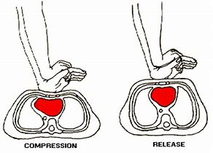
Chest Recoil (IS JUST AS IMPORTANT!)
Full chest wall recoil occurs when the sternum returns to its natural or neutral position during the decompression phase of compressions.
When the chest recoils, the heart fills with blood.
If rescuers “lean” on the chest between compressions and do not allow complete chest recoil, blood return to the heart is reduced and the heart does not fill with as much blood. This reduces the output of the next compression.

Slide 31
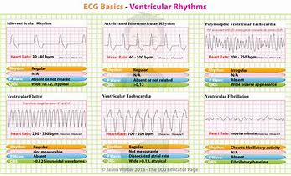
LESS than 10 second interruptions
Interruptions in chest compressions, whether intended (eg. for required care such as rhythm analysis) or unintended, will stop blood flow.

Slide 32
LESS than 10 second interruptions
Expert consensus is that a goal of 80% chest compression fraction (proportion of resuscitation time that chest compressions are performed) is achievable if the team trains well and works together.This requires minimizing both the number and duration of interruptions in chest compressions. The Guidelines recommendations (see below) note that the chest compression fraction should be at least 60%, but CPR Quality experts note that a goal of 80% is very achievable.

Slide 33
LESS than 10 second interruptions
Interruptions in chest compressions for attempted defibrillation requires team coordination and practice to minimize the pause between the last compression and shock delivery, and to ensure that compressions are resumed immediately after shock delivery.
Shorter interruptions for shock delivery are associated with greater likelihood of shock success, greater likelihood of return of spontaneous circulation, and greater survival to hospital discharge.

Slide 34
Switch Compressors
When 2 or more rescuers are available it is reasonable to switch chest compressors approximately every 2 minutes (or after about 5 cycles of compressions and ventilation at a ratio of 30:2) to prevent decreases in the quality of compressions. (Class IIa, LOE B) (2010 Part 5)

Slide 35
Switch Compressors
Consider switching compressors during interventions associated with appropriate interruptions in chest compressions (eg. when an AED is delivering a shock).
Every effort should be made to switch compressors in <5 seconds.
If the 2 rescuers are present, they can be positioned on either side of the patient, so 1 rescuer will be ready and waiting to relieve the “working compressor” every 2 minutes.

Slide 36
Compression to Ventilation (30:2)
The rescuer delivers breaths during pauses in compressions and delivers each breath over approximately 1 second. (Class IIa, LOE C-LD) (2015 Part 5)
It is reasonable that before placement of an advanced airway (supraglottic airway or tracheal tube), EMS providers perform CPR with cycles of 30 compressions and 2 breaths. (Class IIa, LOE B-R) It may be reasonable for EMS providers to use a rate of 10 breaths per minute (1 breath every 6 seconds) to provide asynchronous ventilation during continuous chest compressions before placement of an advanced airway. (Class IIb, LOE B-R) (2017 Update)

Slide 37
Airway Management
Head tilt-Chin lift
was developed using unconscious, paralyzed adult volunteers and has not been studied in victims with cardiac arrest, clinical and radiographic evidence and a case series have shown it to be effective
Jaw Thrust Maneuver
Suspected spinal injury

Slide 38
Rescue Breaths and Breathing
During CPR, cardiac output is about 25% to 33% of normal, so oxygen uptake from the lungs and CO₂ delivery to the lungs are also reduced. As a result, a low minute ventilation (tidal volume lower than normal and respiratory rate slower than normal) can maintain effective oxygenation and ventilation.

Slide 39
Rescue Breaths and Breathing
Excessive ventilation is not necessary and can be harmful because it increases intrathoracic pressure, decreases venous return to the heart, and decreases cardiac output and survival. It can also cause gastric inflation and resultant complications such as regurgitation and aspiration.

Slide 40
Rescue Breaths and Breathing
When a perfusing rhythm is present, pulmonary blood flow and carbon dioxide delivery to the lungs may be normal or near-normal, so a slightly higher ventilation rate will likely be required to match ventilation to perfusion. See Ventilation During CPR with an Advanced Airway.

Slide 41
HIGHLIGHTS of Rescue Breaths and Breathing
Deliver each rescue breath over 1 second. (Class IIa, LOE C) (2010 Part 5)
Give a sufficient tidal volume to produce visible chest rise. (Class IIa, LOE C) (2010 Part 5)
During adult CPR tidal volumes of approximately 500 to 600 mL (6 to 7 mL/kg) should suffice. (Class IIa, LOE B) (2010 Part 5) This is consistent with a tidal volume that produces visible chest rise.
Rescuers should avoid excessive ventilation (too many breaths or too large a volume) during CPR. (Class III, LOE B) (2010 Part 5)
If an adult victim with spontaneous circulation (eg. strong and easily palpable pulses) requires support of ventilation, the healthcare provider should give rescue breaths at a rate of about 1 breath every 5 to 6 seconds, or about 10 to 12 breaths per minute. (Class IIb, LOE C) (2010 Part 5)

Slide 42
Airway Management: Lay Rescuer vs HCP
Lay rescuer:
For victims with suspected spinal injury, rescuers should initially use manual spinal motion restriction (eg. placing 1 hand on either side of the patient’s head to hold it still) rather than immobilization devices, because use of immobilization devices by lay rescuers may be harmful. (Class III: Harm, LOE C-LD) (2015 Part 5)
The trained lay rescuer who feels confident that he or she can perform both compressions and ventilation should open the airway using a head tilt–chin lift maneuver. (Class IIa, LOE B) (2010 Part 5)
HCP:
If healthcare providers suspect a cervical spine injury, they should open the airway using a jaw thrust without head extension. (Class IIb, LOE C) (2010 Part 5)
Because maintaining a patent airway and providing adequate ventilation are priorities in CPR (Class I, LOE C), use the head tilt–chin lift maneuver if the jaw thrust does not adequately open the airway. (2010 Part 5)
VS

Slide 43
Mouth to Mouth (Rescue Breathing)
Mouth-to-mouth rescue breathing provides oxygen and ventilation to the victim.
Give 1 breath over 1 second, take a “regular” (not a deep) breath, and give a second rescue breath over 1 second. (Class IIb, LOE C) (2010 Part 5)

Slide 44
Mouth to Nose (Rescue Breathing)
Mouth-to-nose ventilation is recommended if ventilation through the victim’s mouth is impossible (eg, the mouth is seriously injured), the mouth cannot be opened, the victim is in water, or a mouth-to-mouth seal is difficult to achieve. (Class IIa, LOE C) (2010 Part 5)

Slide 45
Mouth to Stoma (Rescue Breathing)
Give mouth-to-stoma rescue breaths to a victim with a tracheal stoma who requires rescue breathing. A reasonable alternative is to create a tight seal over the stoma with a round, pediatric face mask. (Class IIb, LOE C) (2010 Part 5)

Slide 46
Bag-mask Ventilation (with advanced airway)
When the victim has an advanced airway in place during CPR, rescuers no longer deliver cycles of 30 compressions and 2 breaths (ie, they no longer interrupt compressions to deliver 2 breaths). Instead, it may be reasonable for the provider to deliver 1 breath every 6 seconds (10 breaths per minute) while continuous chest compression are being performed. (Class IIb, LOE C-D) (2015 Part 5)
Whenever an advanced airway (endotracheal tube or supraglottic device) is inserted during CPR, it may be reasonable for providers to perform continuous compressions with positive-pressure ventilation delivered without pausing chest compressions. (Class IIb, LOE C-LD) (2017 BLS)
It may be reasonable for the provider to deliver 1 breath every 6 seconds (10 breaths per minute) while continuous chest compressions are being performed. (Class IIb, LOE C-LD) (2015 Part 5)

Slide 47
Single vs Multi-rescuer with AED
Single rescuer:
After activating the emergency response system, retrieve an AED (if nearby and easily accessible) and then return to the victim to attach and use the Automated External Defibrillator (AED) and provide CPR.
Two or more trained rescuers:
One rescuer begins CPR, starting with chest compressions.
Second rescuer activates the emergency response system and gets the AED (or a manual defibrillator in most hospitals) and other emergency equipment.
Use the AED or manual defibrillator as rapidly as possible.
Both rescuers provide CPR with chest compressions and ventilation.
VS

Slide 48
Team-Based Resuscitation
Resuscitation from cardiac arrest most often involves a team of caregivers with varied experience and composition.
A designated team leader directs team activities with the aim to minimize interruptions in CPR, ensure delivery of adequate compression rate and depth, minimization of leaning and avoidance of excessive ventilation.

Slide 49
Foreign Body (Choking)
Although chest thrusts, back slaps, and abdominal thrusts are feasible and effective for relieving severe foreign body airway obstruction in conscious (responsive) adults and children >1 year of age, for simplicity in training it is recommended that abdominal thrusts be applied in rapid sequence until the obstruction is relieved. (Class IIb, LOE B) (2010 Part 5)
If abdominal thrusts are not effective, the rescuer may consider chest thrusts. (Class IIb, LOE B) (2010 Part 5)

Slide 50
Foreign Body (Choking)
If the patient looses consciousness, begin CPR. HOWEVER, ALWAYS CHECK FOR THE OBSTRUCTING OBJECT before providing breaths

Slide 51
Recovery Position
There are several variations of the recovery position. The position used should be stable, near a true lateral position, with the head dependent and with no pressure on the chest to impair breathing. (Class IIa, LOE C) (2010 Part 5)

Slide 52
Citation:
American Heart Association. Web-based Integrated Guidelines for Cardiopulmonary Resuscitation and Emergency Cardiovascular Care – Part 5: Adult Basic Life Support and Cardiopulmonary Resuscitation Quality. ECCguidelines.heart.org.

Slide 53
“Learn, act, save lives”
- Beat to beat training LLC

